Slide 1
A Hyper-heuristic for Bin Packing Problem

Slide 2
Plan
Introduction
Bin Packing Problem
Review ??
Proposal solution
Test
Synthetis & Conclusion

Slide 3
Introduction
A hyper-heuristic is a high level search methodology which performs a search over the space of heuristics rather than the space of solutions for solving hard computational problems.
The idea of combining different heuristics (neighbourhood operators) with the goal of exploiting their strengths dates back to the early 1960s. [1]

Slide 4
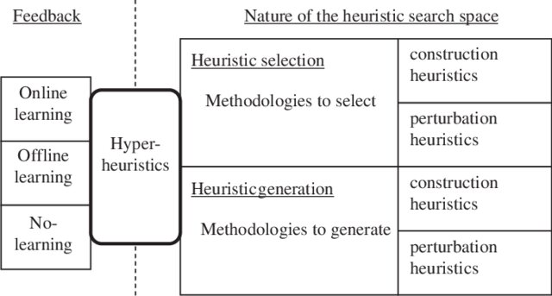
Hyber-heuristic classification [2]
Notes:
This classification considers two dimensions: (i) the nature of the heuristics’ search space, and(ii) the different sources of feedback information. According to the nature of the search space, we have (i) heuristic selection: methodologies for choosing or selecting existing heuristics, and (ii) heuristic generation: methodologies for generating new heuristics from the components of existing ones.
[2] Burke, Edmund & Gendreau, Michel & Hyde, Matthew & Kendall, Graham & Ochoa, Gabriela & Özcan, Ender & Qu, Rong. (2013). Hyper-heuristics: A survey of the state of the art. Journal of the Operational Research Society. 64. 1695-1724. 10.1057/jors.2013.71.

Slide 5
Perturbative methods work by considering complete candidate solutions and changing them by modifying one or more of their solution components,
while constructive methods work by considering partial candidate solutions, in which one or more solution components are missing, and iteratively extending them.
Notes:
A second level in this dimension corresponds to the distinction between constructive and perturbative search paradigms (Hoos and Stu ̈tzle, 2004).

Slide 6
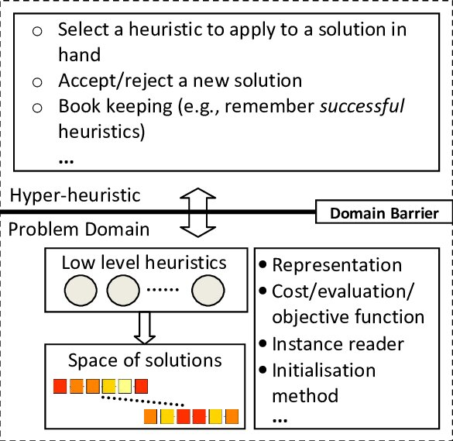
Architecture of Hyber-heuristic

Slide 7
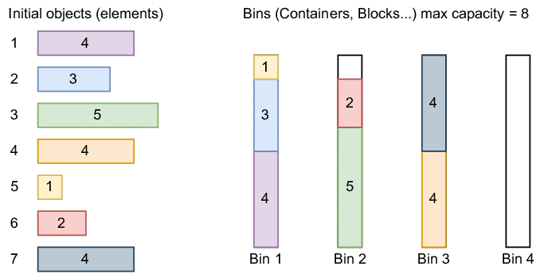
Bin Packing Problem
Notes:
The bin packing problem consists of assigning N items of differing sizes into the smallest number of bins each with capacity c

Slide 8
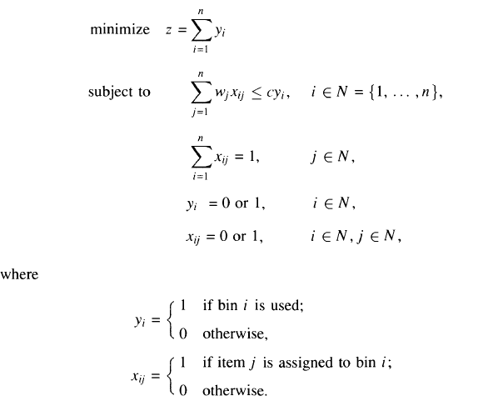

Slide 9
Proposal solution
hyperheuristique UCB
hyperheuristique avec la recherche Tabou (TS)
hyperheuristique avec AG
We put an architecture based on our choise!

Slide 10
References
[1] Kalender, Murat & Kheiri, Ahmed & Özcan, Ender & Burke, Edmund. (2013). A greedy gradient-simulated annealing selection hyper-heuristic. Soft Computing. 17. 2279-2292. 10.1007/s00500-013-1096-5.
[2] Burke, Edmund & Gendreau, Michel & Hyde, Matthew & Kendall, Graham & Ochoa, Gabriela & Özcan, Ender & Qu, Rong. (2013). Hyper-heuristics: A survey of the state of the art. Journal of the Operational Research Society. 64. 1695-1724. 10.1057/jors.2013.71.

